Slide 1

MACHINE LEARNING AND ITS APPLICATION FOR TOOL WEAR PREDICTION
AYUB AHMED

Slide 2



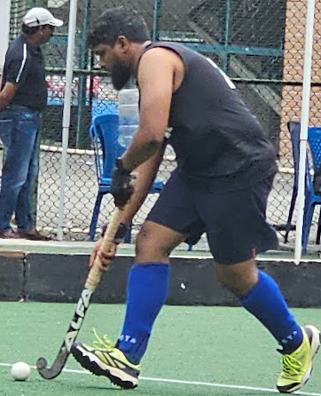

AYUB AHMED

Slide 3






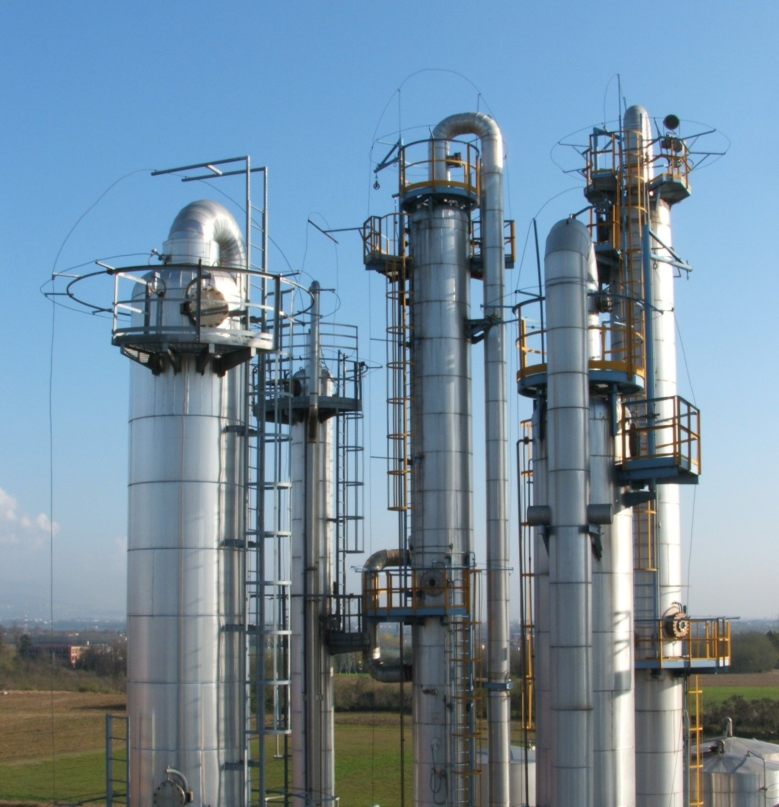
DATA IS THE OIL OF THE 21ST CENTURY
SIMILARITIES
DIFFERNCES
Very Useful
Both require collection
Require proper storage
Quality - Garbage in Garbage out
Both require DISTILLATION
Oil is an Exhaustible resource whereas the same data can be used multiple times
Data ages like wine – Older data is good to have

Slide 4
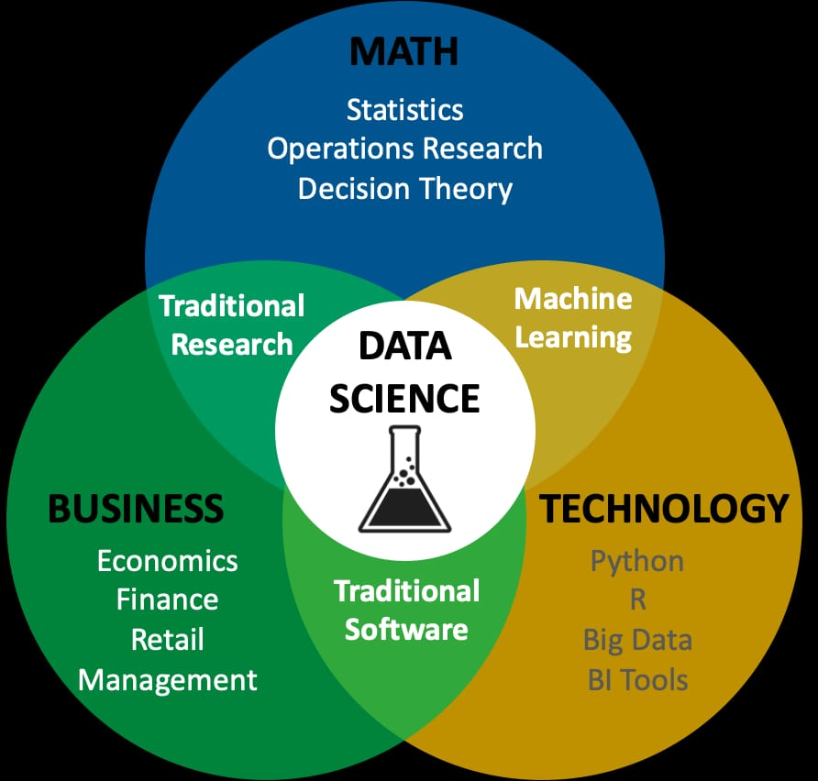
The process of distilling the data to get information is called Data Science
AI is built based on data science to generate this information at scale in real-time without human intervention, Example: Retail, Food Delivery, etc.
Notes:
Talk about examples of AI here:
Retail :
Food Delivery :

Slide 5
Let’s look at the spectrum of problems that can be solved using DS and AI
DESCRIPTIVE
PREDICTIVE
PRESCRIPTIVE

Slide 6
Classification of ML
Types of ML
Supervised Learning
Unsupervised Learning
Regression
Classification
Association
Linear, Polynomial, kNN, Ridge & Lasso
CART, RF, GBM, XGBoost
Logistic
Time Series
ANN
DT, RF
GBM, XGBoost
ANN
kNN
Apriori Algorithm
Anomaly Detection
PCA
Clustering
K-means
Hierarchichal
DB Scan

Slide 7
Appendix

Slide 8
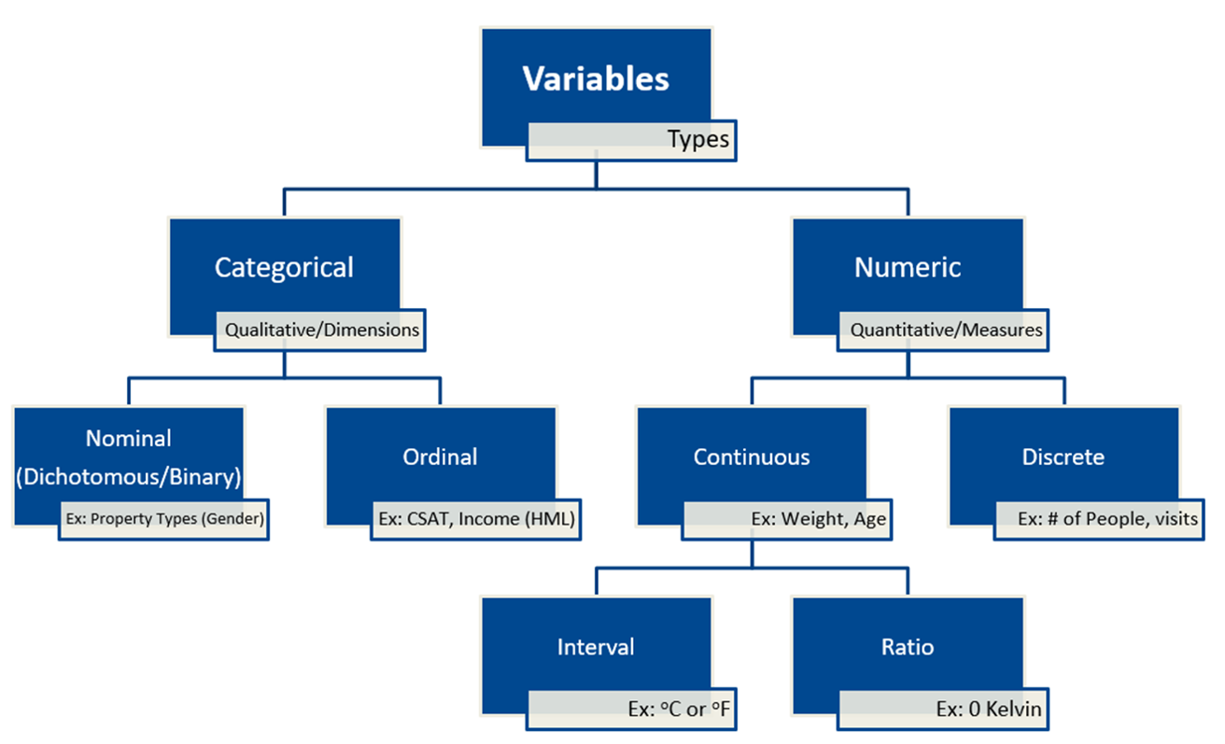
Types of Variables

Slide 9
Acknowledgements
This Photo is licensed under CC BY-NC
This Photo is licensed under CC BY-SA
This Photo is licensed under CC BY-SA

